Slide 1
Multi-sectoral services and responses for women and girls subject to violence: the case of Timor-Leste
Luisa Reis Marcal
Coordinator Fatin Hakmatek, PRADET
(Psychosocial Recovery and Development in East Timor)
6 March 2013

Slide 2
Timor-Leste: Introduction and history
Small population just over 1 million
Young population – mean age 15 years
Rural, subsistence agriculture, high rates of poverty and illiteracy
Widespread human rights abuses for 24 years during Occupation
Major changes after Referendum in 1999 including 80% destruction and UN arriving.

Slide 3
Statistics on violence against women
33% of Timorese women have experienced violence since the age of 15
rates being higher in urban areas and women with higher education more likely to report abuse.
29% of women thought that marital rape was acceptable
only 24% of women who have experienced violence seek help, with over 80% of them seeking help from their family and only 4% going to the Police and a 1% seeking help from social service agencies
Demographic and Health Survey 2010

Slide 4
PRADET’s work on violence against women
“Fatin Hakmatek” (Safe Place) started in 2002 with funds from IRC after two years of consultation with women’s NGOs
Based in Dili National Hospital
PRADET’s focus is on on trauma and mental health issues, which included trauma of domestic violence and sexual assault. Staff have medical background, augmented with training on counseling.

Slide 5
Development of the service over time
Now expanding to the five District Referral Hospitals with support from AusAID. There will eventually be 6 facilities in the country.
In 2012 FH received 293 new referrals,
Since opening in 2002 until December 2012 F.H has provided service to a total of 1,544 victims.

Slide 6
Services offered
Free counseling
Medical treatment (injuries, STIs, screening for mental health issues, screening for other non-abuse related health issues)
Forensic documentation of injuries and collection of evidence for a possible court case
Practical assistance (food, clothes and transportation)
Emergency accommodation (up to three nights)
Follow-up services and referral to other services

Slide 7
Our facilities
Purpose-designed facility which keeps the clinical area (for victims) separate from the administrative area (for meetings and visitors)
Located in hospital grounds for easier access to medical treatment, X-Ray, medications, etc.
24 hour security
private medical examination room and counselling room
a homely environment with space for clients, staff and volunteers to work and relax in. Two sleeping rooms for victims and their children.
open five days (Monday-Friday) with an after hours service for emergencies. All Fatin Hakmatek have a 24 hours mobile phone number.
key staff positions are Coordinator, Counsellor, Administrator, Driver, Security, Cook/Cleaner
Coordinators and Counsellors have medical (midwife or nurse) or legal background
International Mentor (part-time) provides clinical and technical support

Slide 8
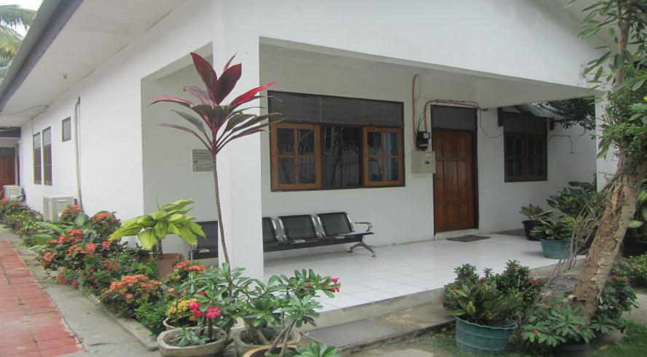
A photo of a Fatin Hakmatek facility

Slide 9
Medico-Legal Response
Innovation – In 2004 supported by UNFPA, PRADET developed a Medical Forensic Protocol for documentation of injuries and other evidence. PRADET then consulted and obtained support from government including: Min of Health, Min of Justice, SEPI, Prosecutor General and Police.
Three languages
Training for medical professionals (nurses, midwives, doctors) – accredited by Min of Health and Min of Justice
Ongoing discussion about: 1) midwives performing this activity; and 2) clarification that government has authorized PRADET as a non-governmental entity to forensically document potential evidence

Slide 10
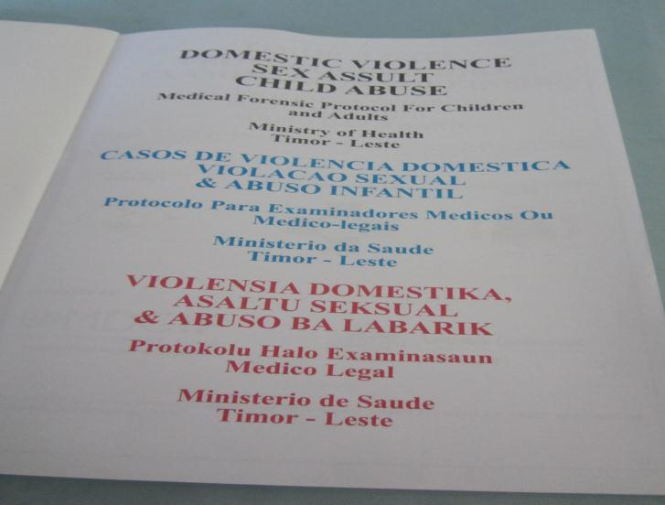
Some pages of protocol

Slide 11
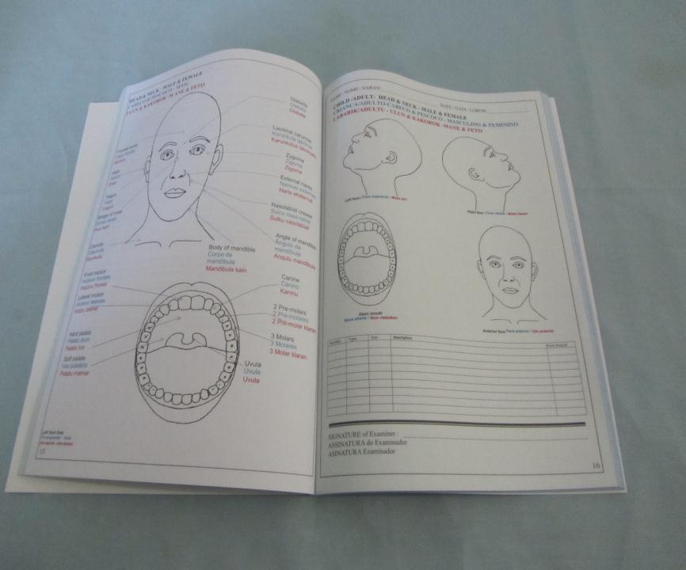

Slide 12
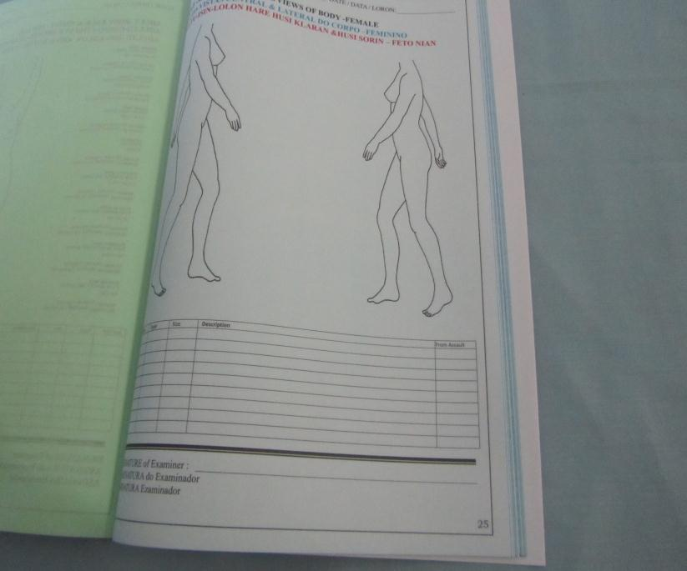

Slide 13
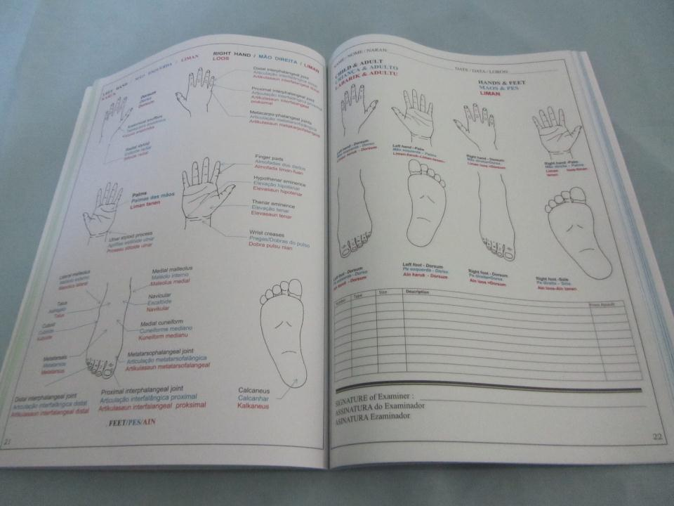

Slide 14
Relationships with other sectors
Referral networks – coordination of cases with other Service Providers.
Police – Vulnerable Persons’ Units in every district
Legal assistance – specialized service for women and children
Health care – informal coordination and training
MSS – child protection, financial assistance

Slide 15
Relationships with other sectors (cont’d)
Government – Ministry of Social Solidarity: regulations for services, some funds for services, referrals.
Ministry of Health: land for facilities
Communities and local leaders – awareness raising activities, with emphasis on school students
Advocacy – about issues that things that need to improve.

Slide 16
Areas for further work by Government and NGOs to improve services
Professional training and ongoing support and supervision for staff.
Enhanced follow-up services – particularly safety, livelihoods and housing.
Special services for particular groups - young women, women with disabilities and women with mental illnesses
More work with men for prevention. Only two small organizations are working on this.
More Programs for perpetrators not only anger management

Slide 17
Areas for further work for improved services (cont’d)
Strengthening implementation of National Action Plan on GBV – through making stronger links with service provision and quality of services
Better funding for services – long-term, predictable, adequate. Funds need to cover core operating costs, over multiple years. Government will need time to fulfill its obligations.

Slide 18
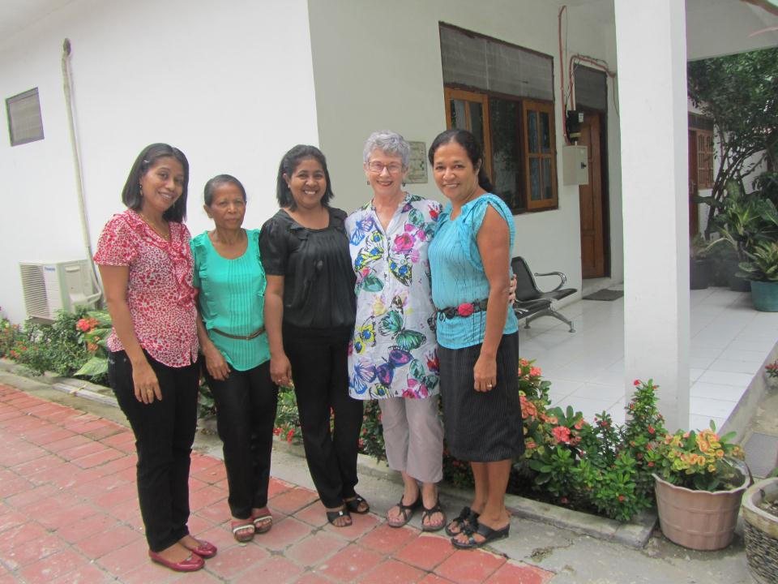
Thank you from the staff at PRADET

