Slide 1
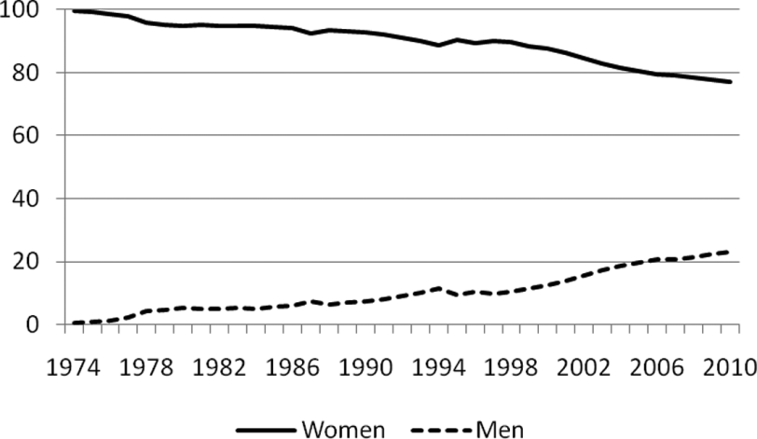
Parental leave policy in Sweden: evolution, lessons learned Niclas Järvklo, Governmental Commission on Men and Gender Equality, Sweden
Fundamental reforms for gender equality development in Sweden:
the individual taxation law of 1971 (spouses were taxed individually)
the 1974 parliamentary decision to expand universal child care provision
the parental insurance scheme of 1974 (with reserved time for fathers in 1995 and 2002)
Figure 1. Women’s and men’s share of used parental leave benefit days, 1974–2010.

